Slide 1

ZERO LECTURE
PES 509
Soft Skills
A Path to learn and grow

Slide 2
Credit details
Lecture: 2
Tutorial: 2
Practical : 0
L:T:P=2:2:0

Slide 3
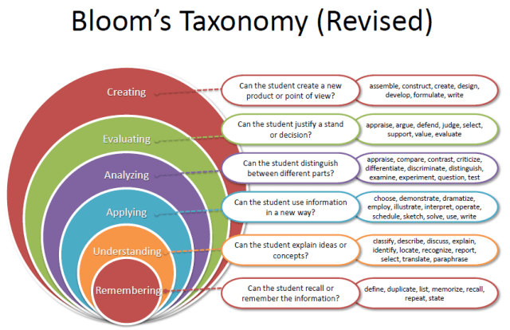
Course Outcomes- PES509

Slide 4


Course Outcomes- PES509
Identify the career and industry expectations
Develop the skills, confidence, and creating a brand with respect to career
Apply the skills, learnings, experiences in the discussions , interview
learn and understand about the opportunities
Appraise the assertive communication, leadership skills oriented toward the industry
Outline and improvise the results and the approach through the presentation

Slide 5
Program Outcomes- PES509
Ethics::Apply ethical principles and commit to professional ethics and responsibilities and norms of the engineering practice | Individual and team work::Function effectively as an individual, and as a member or leader in diverse teams, and in multidisciplinary settings. | Communication::Communicate effectively on complex engineering activities with the engineering community and with society at large, such as, being able to comprehend and write effective reports and design documentation, make effective presentations, and give and receive clear instructions. | Life-long learning::Recognize the need for, and have the preparation and ability to engage in independent and life-long learning in the broadest context of technological change.

Slide 6

CONTENT
Unit 1:Communication skills: Listening and comprehending skills. verbal communication, nonverbal communication, and para verbal communication prepare a topic to present and stage handling.
Unit 2: Making own profile: Job Vs Career, SWOT, USP, creating an effective elevator pitch, offline branding tools- CV Online brand as on LinkedIn, Video CV, Product based, service based, non-technical profile.
Unit 3: Career essentials:Introduction to workplace and workstation, email etiquette, grooming, upskilling.

Slide 7
CONTENT
Unit 4: Group Discussions: Introduction to group discussion, group discussion etiquette, do's and don’ts in group discussion, virtual group discussion and offline group discussion, idea generation techniques (SPELT, KWA, POPBEANS, 5W's 1H, VAP), group interaction.
Unit 5:Interview Skills: Interview preparation, power dressing, pre-placement talk, answering techniques like STAR, domain-based interview, skills-based, situation-based, behavior-based interviews, asking questions in an interview, offline interview etiquette, and virtual interviews etiquette
Corporate skills: Decision-making skills, critical thinking, taking initiatives, growth mindset, adaptability.

Slide 8


Academic Tasks
Academic Task 1:
Presentation Individual 1=30marks
Academic Task 2:
Presentation Individual 2 and CV evaluation=30marks
Academic Task 3:
Group discussion: 30 marks
Academic Task 4:
Interview skills:30 marks
NO MTE
ATT: 15 CA: 30 ETP: 55

Slide 9

Practical approach
Product based company
Service based Company
Sales & IT skills profile, grooming, digital profile, CV

Slide 10
Books
SOFT SKILLS FOR EVERYONE | JEFF BUTTERFIELD | Reference Book
PROFESSIONAL SPEAKING SKILLS | ARUNA KONERU | Reference Book

Slide 11

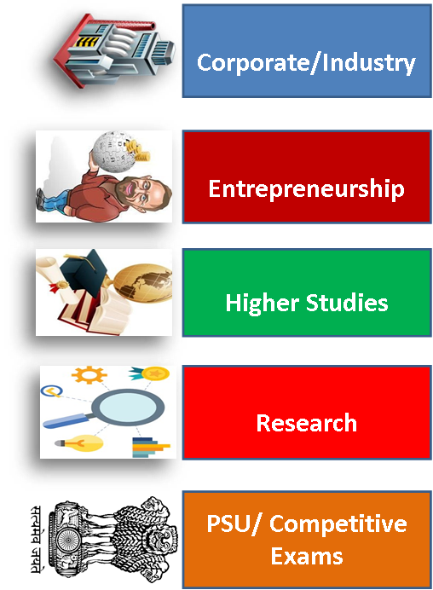
Career Pathways

Slide 12

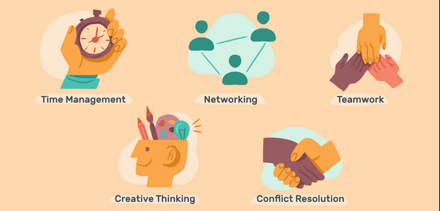
Skills

Slide 13
What is expected?
Be punctual
Be open to learn
Practice ( In the class, home, workshops, events)
Read news paper, work on research papers
Make your profile and knowledge strong

Slide 14
Queries?

Slide 15
Thank you

